Slide 1
Capitalising on “Off-Season” Revenue. Online Merchandise Store & Conversion strategy – VR.
Drive Year-Round Sales & Future Park Visit Strategy…
Nsasani reserve (Pty) Ltd

Slide 2
Business Opportunity $ E-Commerce + Strategic VR teasers
Current Gap:
60% drop in off-season foot traffic (May-August)
Causes: Weather extremes, busy schedules, local competition
Problem: Customer disengagement
Proposed Solution:
Online Store/ E-Commerce site: Ride-branded apparel, collectibles & exclusives (online deals)
Seasonal VR teasers & discounts:
Free 5-minute ride previews redeemable only at park kiosks
Post-VR offer: “Get 15% off your next ticket if you book today"
Advantage:
Merchandise profits fund VR kiosks
VR teasers > return visits
Potential for a contained VR Experience > Accessibility
Problem ID
Controlled experience

Slide 3
Vision & Mission
V:Provide inspiring experiences and memorabilia that encourage people to embrace life and appreciate nature.
M:Transform 25% of park visitors into loyal online shoppers while using immersive VR previews to boost return visits by 10%, creating a powerful synergy where online merchandise purchases unlock exclusive park VR experiences that ultimately drive further in-park engagement and merchandise sales - keeping our brand alive year-round and deepening visitor connections with nature.

Slide 4
Key Business Rules & Assumptions
Merchandises are either linked to a VR teaser or not; customer only knows after checkout.
A Park visit booking resulting from a VR teaser have a guaranteed discount
Each VR session can generate only one discount redemption
Discounts are tracked by type (percentage/fixed) and value
DB tracks both discount amount and the VR session that triggered it
DB tracks whether its discount has been redeemed
Some products/Merchandise may not be attraction-specific

Slide 5
Business Requirements
Functional (Must do)
Non – Functional (Performance)
Flexible Product Management: Support merchandise both linked and not linked to a specific attraction's VR teaser (normal e-commerce & extended strat.)
VR-Discount Linkage: Automatically apply a guaranteed, one-time discount to orders originating from a VR session.
Redemption Tracking: Ensure each VR session's discount can only be redeemed once, tracked from offer to final sale.
Data Integrity: Enforce unique discount redemption rules at the database level to prevent reuse.
Audit Trail: Maintain immutable records of discount offers, values, and redemptions for financial reporting.
System Reliability: Ensure high availability for processing transactions during peak redemption periods.

Slide 6
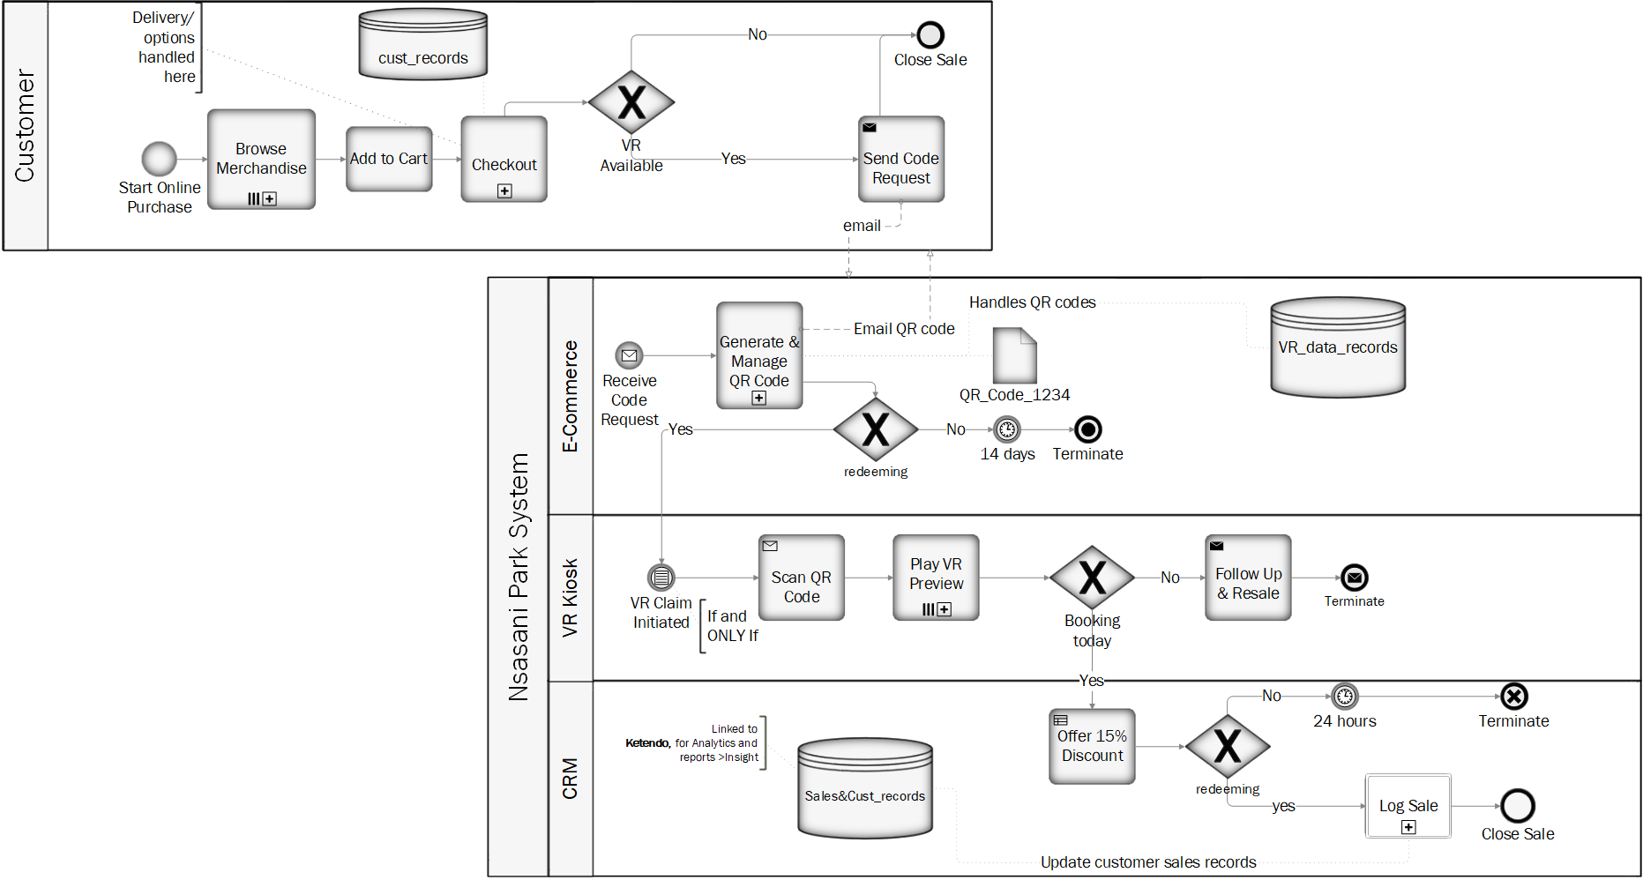
BPM : Nasani Pty Ltd
Simple E-Commerce
e.g. Shopify
Extended VR Strategy
Notes:
Assumptions:
The Collapsed sub process ‘Checkout’ handles deliveries & Instore collection arrangements
It is the ultimate goal of this experience to increase foot traffic
Customer may or may not choose to redeem VR voucher
The collapsed sub process ‘Generate & Manage QR code’ handles the DB records within the system depending on QR code expiry/Validity and generates code depending on whether or not checkout was complete.
A VR preview follows only if customer decided to redeem their code by initiating a claim at the kiosk, alternatively code expires in 14 days
Customer is bound to a discount if they book a park visit from watching a VR teaser
The online Merchandise funds the VR services.

Slide 7
User Scenarios
Standard Purchase (Non-VR Linked)
VR-Linked Purchase & Discount
Browse: Finds a VR-linked product (e.g., attraction-themed t-shirt).
Checkout: Pays full price, selects "In-Park Pickup".
In-Park: Picks up item and is offered a free VR preview.
VR Session: Experiences attraction preview, system generates a discount for a future visit.
Next Visit: Applies discount to a new ticket purchase.
Result:
Two transactions: merchandise + future ticket.
Proven ROI: Direct link from VR to sale.
Drives return visits: Builds loyalty and incremental revenue.
Browse: Finds a generic product (e.g., jacket) online.
Checkout: Pays full price, selects home delivery.
Fulfilment: Product is shipped.
Result:
Single transaction completed.
No data on purchase motivation.
No incentive for a future visit.

Slide 8
Data Flow: Extended VR Strategy
UI Layer
Customer purchases VR-linked merchandise online and selects in-park pickup.
Application Layer
System identifies eligible purchase, triggers discount offer after in-park VR session, and applies discount to future visit.
Data Layer
Stores customer, product, order, and VR session data, enforcing one-time discount use through table relationships
Analytics Layer
Measures campaign success by linking VR sessions to redeemed discounts and calculating incremental revenue.

Slide 9
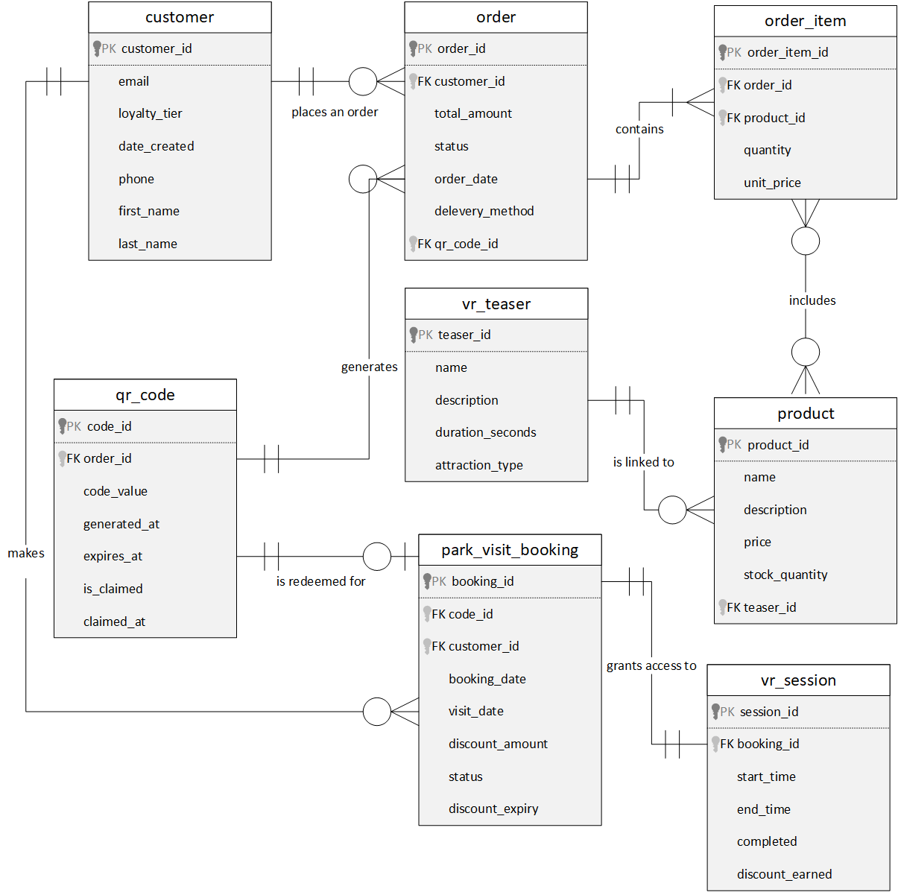
Data Model: ERD
Sale transaction

Slide 10
Risks & Mitigation
Category | Key Risk | Mitigation Strategy | ROI Benefit
Financial | Discount Fraud & Abuse | 1-to-1 session-to-order link prevents reuse | Protects profit margins
 | Low Redemption Rate | Track conversions to optimize discount offers | Increases sales conversion
Operational | Data Silos | Direct link between VR sessions and sales data | Enables precise ROI calculation
 | Inventory Mismatch | Real-time stock checks before offering discounts | Improves customer satisfaction
Marketing | Irrelevant Offers | Discounts tied to specific user VR experiences | Increases redemption rate
 | Poor Timing | Automated time-bound discount expiry | Creates purchase urgency
Strategic | Cannibalization | Compare sales lift from VR vs non-VR users | Measures incremental revenue

Slide 11




Path to Proven ROI
Investment
Activation
Conversion
Result
Fund VR Initiative
Cost of Hardware, Content, & Operation
Drive Low-Season Traffic
Engage Customers with Immersive teasers
Generate Incremental Sales
Tracked via Unique teasers-to-Orders
Calculate & Maximize ROI
Projected ROI: +18% Year 1

Slide 12

Thank You.
Questions & Discussion
Surprise Mhlongo (Mr.) Candidate Graduate BA Mhlongo.surprise@outlook.com LinkedIn
GitHub

